Slide 1

NAAN MUDHALVAN PROJECT(IBM)
IBM AI 101 ARTIFICIAL INTELLIGENCE-GROUP 1
Team no: 09
AI- based diabetes prediction
system
Team members: Dhanush raj D (reg no 1133211036021)
Hemanth V(reg no 113321106132)
Naresh krishna G(reg no 113321106058)
Charan N K(reg no 113321106013) Aravindh L(reg no 113321106004)

Slide 2
AI-Based Diabetes Prediction System
Introduction
Diabetes is a widespread and serious health issue, and artificial intelligence (AI) is now playing a pivotal role in predicting and managing it. AI uses advanced algorithms and patient data to forecast diabetes risk and enhance personalized care. In this discussion, we'll explore how AI is transforming diabetes prediction and management, its data sources, methodologies, and potential benefits for patients and healthcare professionals. This innovation holds the promise of improving the lives of those at risk of or already living with diabetes.An AI-based Diabetes Prediction System is a cutting-edge application of artificial intelligence in healthcare. This system leverages machine learning and data analysis
techniques to predict the risk of diabetes in individuals. By analyzing various factors such as medical history, lifestyle, genetics, and biomarkers, the system can provide early warnings and personalized recommendations for diabetes prevention and management. This introduction sets the stage for understanding the significance and potential of such a system in improving public health and individual well-being.
Database collection and preprocessing
Database Collection and Preprocessing for AI-Based Diabetes Prediction involves gathering data from various sources, cleaning and integrating it, selecting relevant features, normalizing data, addressing imbalances, and ensuring privacy. These steps are crucial for building accurate and reliable prediction models Collection and Preprocessing

Slide 3
Feature engineering:
Feature engineering plays a pivotal role in the development of an AI- based Diabetes Prediction System. This process involves meticulous data manipulation and the creation of new features or modifications to existing ones to enhance the model's predictive capabilities. For instance, age can be categorized or encoded numerically, while BMI can be calculated or categorized for more meaningful input. Blood pressure readings can be combined into a mean arterial pressure, and family history can be encoded as binary variables.
Blood glucose trends and lifestyle factors can be transformed into numerical values, providing valuable insights for the model. By thoughtfully engineering features, one can capture
complex relationships and patterns within the data, ultimately resulting in more accurate predictions of diabetes risk, a critical aspect of proactive healthcare management
Machine Learning Algorithms
Machine learning algorithms are the computational engines that power the intelligence of AI systems. These algorithms are designed to enable computers to learn and make predictions or decisions without being explicitly programmed. They work by analyzing vast amounts of data, identifying patterns, and generalizing from these patterns to make predictions or take actions. There are various types of machine learning algorithms, including supervised learning, where models learn from labeled data to make predictions, and unsupervised learning, where algorithms uncover hidden patterns in unlabeled data. Additionally, reinforcement learning enables machines to learn by interacting with an environment and receiving feedback.
Machine learning algorithms have a wide range of applications, from natural language processing and image recognition to healthcare diagnostics and recommendation systems. The choice of algorithm depends on the specific problem and dataset, and selecting the right algorithm is crucial for the success of machine learning projects.

Slide 4
.
Deployment
Deployment in AI-based diabetes prediction means putting the trained model into real-world use within healthcare systems to assist in patient diagnosis, risk assessment, and treatment recommendations.
User Interface (UI)
User interface (UI) in AI-based diabetes prediction is the graphical or interactive platform that allows healthcare professionals to input data, receive model predictions, and access patient information, making the technology accessible and user-friendly.
Future Work
Future work in AI-based diabetes prediction includes improving model accuracy, enhancing data privacy, and integrating AI into wearable devices for real-time monitoring, ultimately advancing early diagnosis and personalized treatment of diabetes.

Slide 5
DIABETES PREDICTION USING PYTHON:
import pandas as pd
import numpy as np
import matplotlib.pyplot as plt
import seaborn as sns
import warnings
from sklearn.model_selection import train_test_split
from sklearn.preprocessing import StandardScaler
from sklearn import svm
from sklearn.metrics import classification_report
from sklearn.metrics import confusion_matrix
from sklearn.metrics import ConfusionMatrixDisplay
warnings.filterwarnings("ignore", category=UserWarning)
RED = "\033[91m"
GREEN = "\033[92m"
YELLOW = "\033[93m"
BLUE = "\033[94m"
RESET = "\033[0m"
df = pd.read_csv("/kaggle/input/diabetes-data-set/diabetes.csv")
# DATA CLEANING
print(BLUE + "\nDATA CLEANING" + RESET)
# --- Check for missing values
missing_values = df.isnull().sum()
print(GREEN + "Missing Values : " + RESET)
print(missing_values)
# --- Handle missing values
mean_fill = df.fillna(df.mean())
df.fillna(mean_fill, inplace=True)
# --- Check for duplicate values
duplicate_values = df.duplicated().sum()
print(GREEN + "Duplicate Values : " + RESET)
print(duplicate_values)
# --- Drop duplicate values
df.drop_duplicates(inplace=True)
#

Slide 6
DATA ANALYSIS print(BLUE + "\nDATA ANALYSIS" + RESET) # --- Summary Statistics summary_stats = df.describe() print(GREEN + "Summary Statistics : " + RESET) print(summary_stats) # --- Class Distribution class_distribution = df["Outcome"].value_counts() print(GREEN + "Class Distribution : " + RESET) print(class_distribution) # Support Vector Machine Modelling # --- Separate features and target variable print(BLUE + "\nMODELLING" + RESET) X = df.drop("Outcome", axis=1) y = df["Outcome"] # --- Splitting the data into training and testing sets X_train, X_test, y_train, y_test = train_test_split( X, y, test_size=0.2, random_state=42 ) # --- Standardize Features scaler = StandardScaler() X_train = scaler.fit_transform(X_train) X_test = scaler.transform(X_test) # --- init and train SVM model model = svm.SVC(kernel="linear") model.fit(X_train, y_train) # --- Predict on test data y_pred = model.predict(X_test) # --- Evaluate model performance accuracy = model.score(X_test, y_test) print(GREEN + "Model Accuracy : " + RESET) print(accuracy) #

Slide 7
--- Classification Report and Confusion Matrix print(GREEN + "Classification Report : " + RESET) print(classification_report(y_test, y_pred)) print(GREEN + "Confusion Matrix : " + RESET) cm = ConfusionMatrixDisplay.from_predictions(y_test, y_pred) sns.heatmap(cm.confusion_matrix, annot=True, cmap="Blues") plt.show() print("Displayed") # DATA VISUALIZATION print(BLUE + "\nDATA VISUALIZATION" + RESET) # --- Pair Plot print(GREEN + "PairPlot : " + RESET) sns.pairplot(df, hue='Outcome',diag_kind='kde',palette = "Blues") plt.title("Pairwise Relationships") plt.show() # --- Histogram for age distribution print(GREEN + "Histogram : " + RESET) sns.histplot(df["Age"], bins=10, kde=True,palette = "Blues") plt.xlabel("Age") plt.ylabel("Count") plt.title("Age Distribution") plt.show() # --- Box plot to visualize glucose levels by outcome print(GREEN + "BoxPlot : " + RESET) sns.boxplot(x="Outcome", y="Glucose", data=df,palette = "Blues") plt.xlabel("Diabetes Outcome (0: No, 1: Yes)") plt.ylabel("Glucose Level") plt.title("Glucose Levels by Diabetes Outcome") plt.show() # --- Correlation heatmap print(GREEN + "Correlation Heatmap : " + RESET) correlation_matrix = df.corr() sns.heatmap(correlation_matrix, annot=True, cmap="Blues") plt.title("Correlation Heatmap") plt.show() # SAVING THE FILE df.to_csv("/kaggle/working/cleaned_diabetes.csv", index=False) print(BLUE + "\nDATA SAVING" + RESET) print(GREEN + "Data Cleaned and Saved !" + RESET) print("\n")

Slide 8
DATA CLEANING
Missing Values :
Pregnancies 0
Glucose 0
BloodPressure 0
SkinThickness 0
Insulin 0
BMI 0
DiabetesPedigreeFunction 0
Age 0
Outcome 0
dtype: int64
Duplicate Values :
0
DATA ANALYSIS
Summary Statistics :
Pregnancies Glucose BloodPressure SkinThickness Insulin \
count 768.000000 768.000000 768.000000 768.000000 768.000000
mean 3.845052 120.894531 69.105469 20.536458 79.799479
std 3.369578 31.972618 19.355807 15.952218 115.244002
min 0.000000 0.000000 0.000000 0.000000 0.000000
25% 1.000000 99.000000 62.000000 0.000000 0.000000
50% 3.000000 117.000000 72.000000 23.000000 30.500000
75% 6.000000 140.250000 80.000000 32.000000 127.250000
max 17.000000 199.000000 122.000000 99.000000 846.000000
BMI DiabetesPedigreeFunction Age Outcome
count 768.000000 768.000000 768.000000 768.000000
mean 31.992578 0.471876 33.240885 0.348958
std 7.884160 0.331329 11.760232 0.476951
min 0.000000 0.078000 21.000000 0.000000
25% 27.300000 0.243750 24.000000 0.000000
50% 32.000000 0.372500 29.000000 0.000000
75% 36.600000 0.626250 41.000000 1.000000
max 67.100000 2.420000 81.000000 1.000000
Class Distribution :
Outcome
0 500
1 268
Name: count, dtype: int64

Slide 9
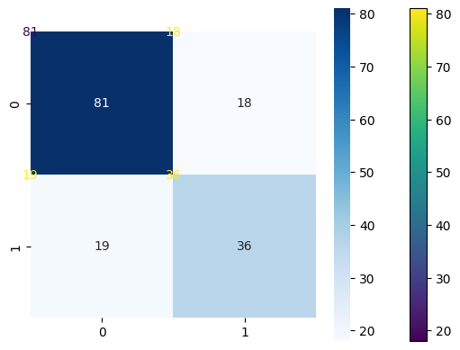
MODELLING
Model Accuracy :
0.7597402597402597
Classification Report :
precision recall f1-score support
0 0.81 0.82 0.81 99
1 0.67 0.65 0.66 55
accuracy 0.76 154
macro avg 0.74 0.74 0.74 154
weighted avg 0.76 0.76 0.76 154
OUTPUT:

Slide 10
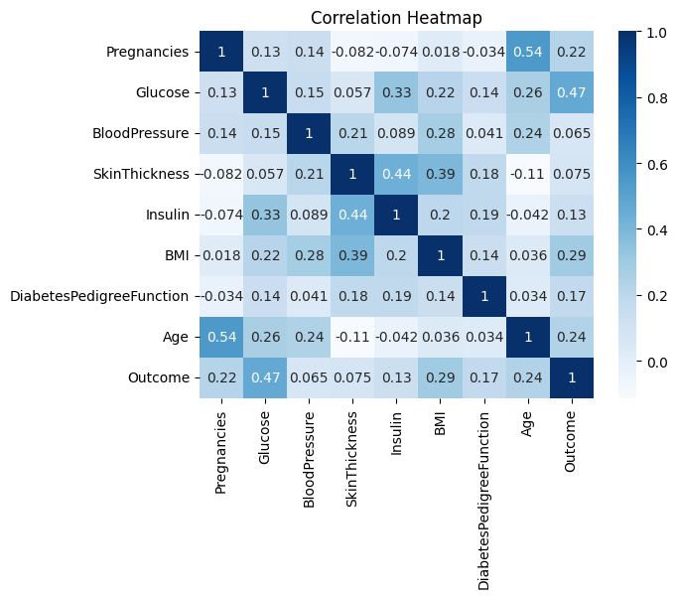
Conclusion
In conclusion, AI is transforming diabetes prediction and management. By leveraging advanced algorithms and data, it holds the promise of early detection, better care, and improved outcomes for individuals with diabetes.

Slide 11
THANK YOU

